Slide 1


AI-Powered Video System
From Prompt to Polished Film
National University of Computer and Emerging Sciences
Technical Implementation Report & Results

Slide 2






Modular Agentic Design
We built the system as a phase-oriented pipeline. Each agent acts as an autonomous specialist, consuming a structured state and producing a verifiable artifact.
Decoupled Logic
Fallback Chain
Async Execution
Separated inference from orchestration to allow individual phase reruns.
Implemented Groq → Ollama → Local logic to ensure 100% uptime.
Used FastAPI background tasks for long-running video synthesis.

Slide 3
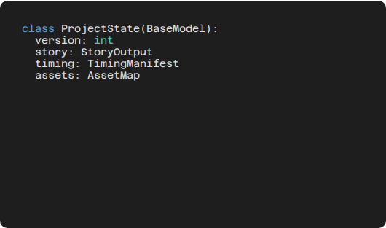
Strict Typed Contracts
To avoid "integration hell," we enforced strict schemas using Pydantic v2. Every phase speaks the same language.
•
ProjectState: Single source of truth.
•
Asset Map: Tracks physical paths of generated media.
•
TimingManifest: Syncs dialogue with visual frames.

Slide 4


Story & Character Identity
How we did it:
Identity Anchoring:
Used specific System Prompts to force JSON output from LLMs. Extracted character metadata early to anchor visual descriptions.
Used Pollinations API to create "Casting Portraits." These serve as reference points for the Video Agent to maintain consistency.

Slide 5
High-Fidelity Audio Synthesis
Requirement | Our Solution | Why it worked
Natural Speech | Edge-TTS (Neural) | Zero cost, high emotional range.
Dialogue Sync | Dialogue Timeline | Mapped characters to timestamps.
Multi-Speaker | Voice Mapping | Assigned gender/pitch per character.

Slide 6
Video Synthesis & Synchronization
The Generation Strategy
Lip-Sync Methodology
We leveraged Wan2.1 via a Gradio client. Prompts were dynamically enriched with character metadata and lighting cues from Phase 1.
Instead of global sync, we performed Segment-wise Lip-Sync. We split video by dialogue timestamps, applied Wav2Lip to active segments, and merged using FFmpeg.

Slide 7



Immutable State Snapshotting
A key challenge was Undo/Redo. We solved this by treating the project directory as a versioned vault.
State Capture
Asset Mirroring
Pointer Update
Reversion
Serialize Pydantic object to state.json.
Copy physical files to version folder.
Update "Latest" pointer in metadata.
Restoring state restores full UI context.

Slide 8
Results: What We Achieved
0
N
Optimized
PRODUCTION TIME
MANUAL STEPS
UNDO LAYERS
Result: A fully autonomous system capable of generating consistent, edited short films in minutes.

Slide 9



Technical Lessons Learned
Contract over Code
Local vs Cloud
Modular UX
Defining the JSON schema first saved 50+ hours of integration debugging.
Local models (Ollama) are vital for cost control but need high-end VRAM.
Visual progress polling is better than a simple loading spinner.

Slide 10

What We Would Do Differently
1. Intent Classification
2. Caching Layer
Instead of rule-based parsing, we'd use LangGraph for more complex edit requests (e.g., "Make the tone darker").
We'd implement a per-prompt content hash to avoid regenerating identical audio/video clips during edits.
Reflection: The bottleneck remains Video VRAM. Moving to a distributed GPU worker pool would be our next priority.

Slide 11




The Future Roadmap
Fine-tuned Voice
Resolution Upscaling
Agent Self-Correction
Integration of ElevenLabs for higher emotional fidelity.
Real-ESRGAN post-processing for 4K delivery.
Vision-agents to "watch" the video and auto-correct glitches.

Slide 12
Questions?
AI-Powered Video Generation System
Umer Farooq | Muhammad Usman | Muhammad Irtaza | Muhammad Ahmed
FAST NUCES Islamabad © 2026

